Slide 1
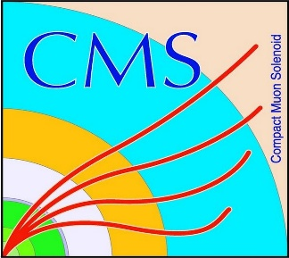

HEP Weekly Report
George Bakas
NTUA

Slide 2
Progress Report
DCS
dbEditorAndNavigator in fwInstallationUtils component
Improvements to the component
Redundancy task
Analysis
Theoretical top anti-top pair spin correlation in fully hadronic decay
Production with data
Produced ntuple that has just 5 variables
Particle Id, Mass, P_{T}, phi, eta
By identifying the particle from the beginning and the whole top anti-top pair processes → see spin correlation from angular distributions

Slide 3
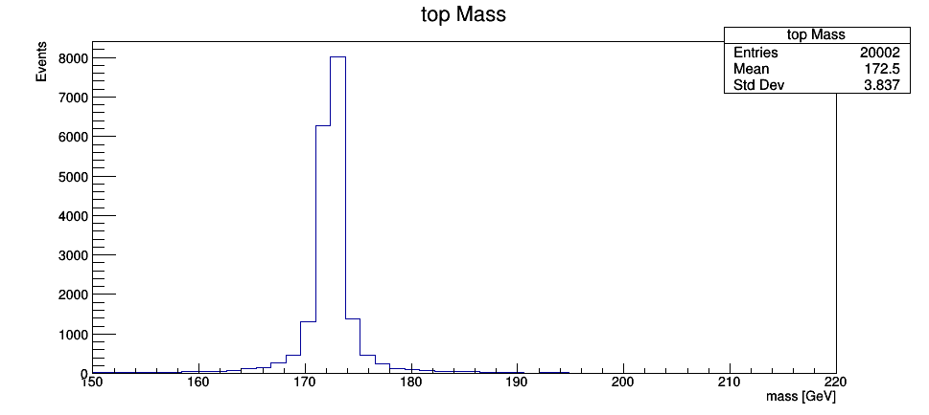
Top quark Mass

Slide 4
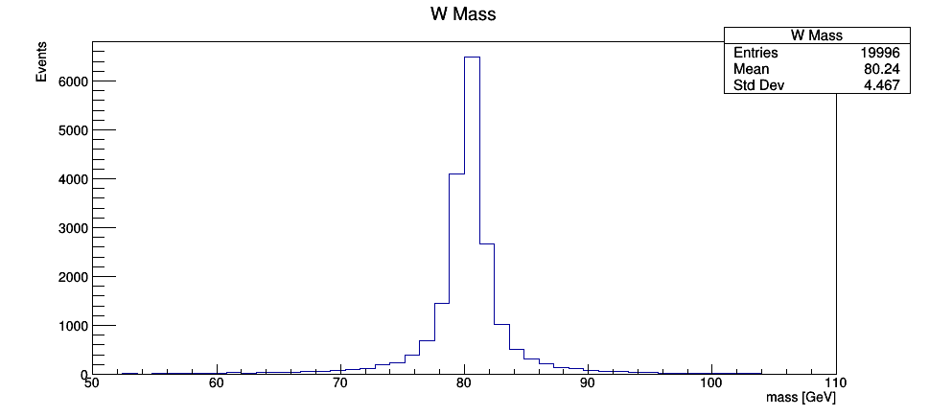
W Mass

Slide 5
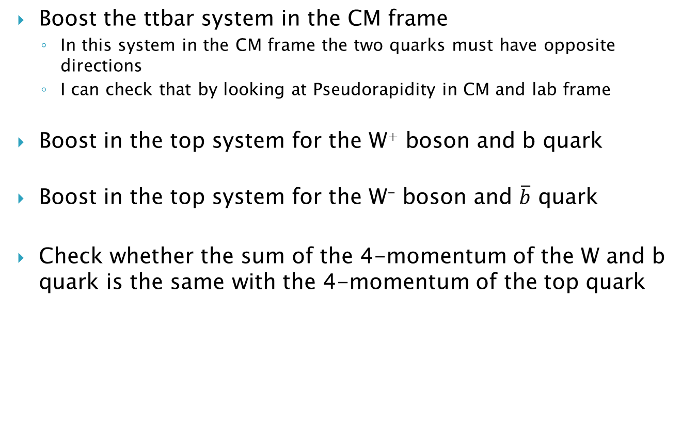
Tasks
Boost the ttbar system in the CM frame
In this system in the CM frame the two quarks must have opposite directions
I can check that by looking at Pseudorapidity in CM and lab frame
Boost in the top system for the W⁺ boson and b quark
Boost in the top system for the W⁻ boson and $\overline{b}$ quark
Check whether the sum of the 4-momentum of the W and b quark is the same with the 4-momentum of the top quark

Slide 6
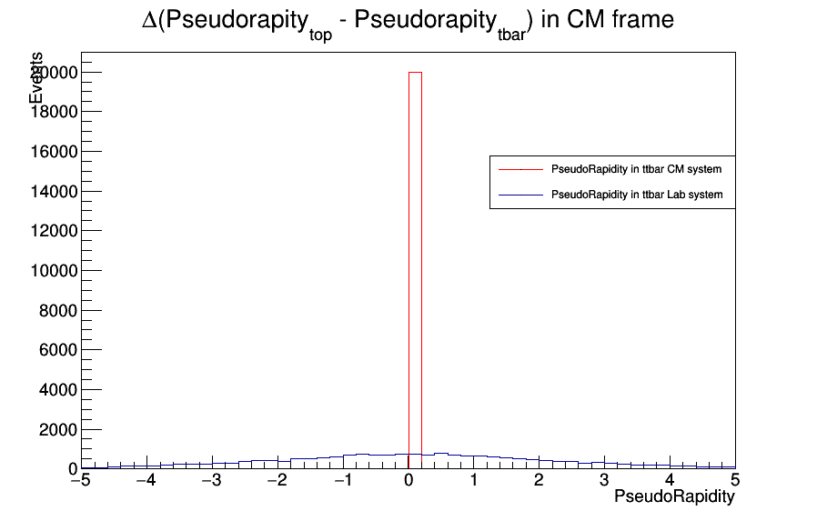
Pseudorapidity of ttbar in ttbar CM frame

Slide 7
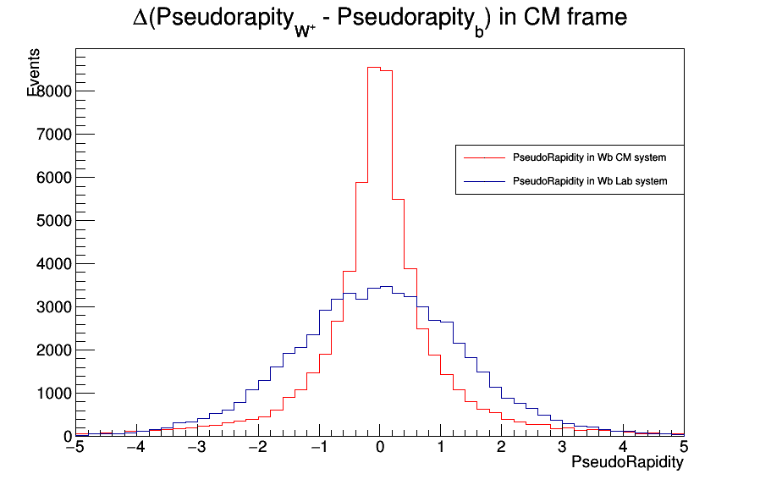
Pseudorapidity of W⁺, b in top CM frame

Slide 8
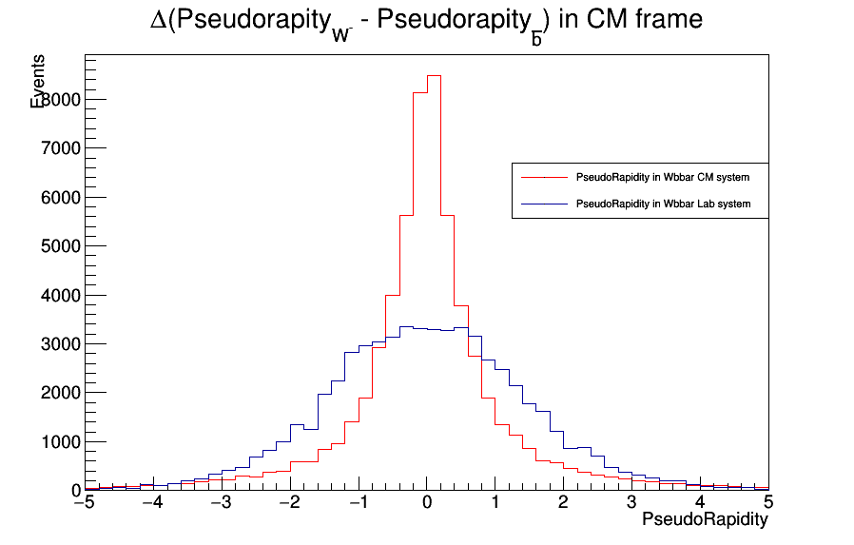
Pseudorapidity of W⁻, bbar in tbar CM frame

Slide 9
